Slide 1
IT1007
TUTORIAL / LAB 3

Slide 2
SEQUENCES

Slide 3

What are Sequences?
“Glue” data together
Notes:
Box that contains several apples, apples are elements of the sequence, box is the data structure that holds it (e.g. tuple, list, dict)

Slide 4
Remember String Slicing?
s = “abcdef”
>>> s[0]
‘a’
>>>s[1:4]
‘bcd’
>>>s[-1]
‘f’
Notes:
Box that contains several apples, apples are elements of the sequence, box is the data structure that holds it (e.g. tuple, list, dict)

Slide 5
Sequences
0
1
2
3
Notes:
Sequence[0] = first apple, [1] = second apple etc

Slide 6
Tuples
>>>a = (1,2,3,4,5,6,7,8)
>>>a[0]
1
>>>s[1:4]
(2, 3, 4)
>>>a = (1)
>>>b = (1,)
>>>type(a)
<class ‘int’>
>>>type(b)
<class ‘tuple’>

Slide 7
Tuples
>>>a = (1,2,3)
>>>b = (4,5,6)
>>>c = a+b
>>>a*2
(1,2,3,1,2,3)
>>>c
(1,2,3,4,5,6)

Slide 8
Tuple-ception
>>>a = (1,2,3)
>>>b = (4,5,6)
>>>c = (a,b)
>>>c
((1,2,3),(4,5,6))

Slide 9
Tuple Illustration
a
b
c
1
2
3
4
5
6

Slide 10
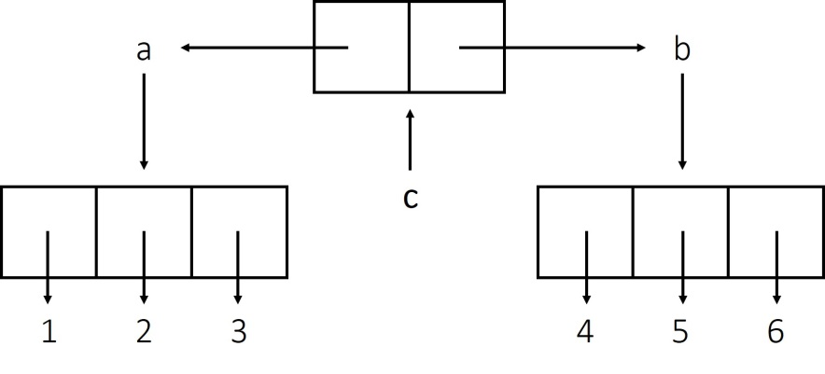
Tuple-ception
>>> a = (1,2,3)
>>> b = (4,5,6)
>>> c = (a,b)
>>> c[0]
(1,2,3)
>>> c[1][2]
6
>>> len(a)
3
>>> len(c)
2

Slide 11
What’s the Difference?
>>> x = (1,2,3)
>>> y = x
>>> y += (3,2,1)
print(x)
print(y)
x[0] = 5
>>> x = [1,2,3]
>>> y = x
>>> y += [3,2,1]
print(x)
print(y)
x[0] = 5
(1,2,3)
[1,2,3,3,2,1]
(1,2,3,3,2,1)
[1,2,3,3,2,1]
TypeError
[5,2,3,3,2,1]
Tuples are immutable and cannot be modified but lists can!

Slide 12
Trouble of List
When you do
y = x
You do NOT have two list
y IS x, they share the same contents
If you want to clone another copy for y, you can
y = list(x)
x = [1,2,3]
y = x
y += [3,2,1]
print(x)
print(y)
x[0] = 5
[1,2,3,3,2,1]
[1,2,3,3,2,1]
[5,2,3,3,2,1]

Slide 13
Trouble of List
When you do
y = x
You do NOT have two list
y IS x, they share the same contents
If you want to clone another copy for y, you can
y = list(x)
x = [1,2,3]
y = list(x)
y += [3,2,1]
print(x)
print(y)
x[0] = 5
[1,2,3]
[1,2,3,3,2,1]
[5,2,3]

Slide 14
List Manipulation
>>>a.append(5)
>>>a
[0,1,2,3,4,5]
Same as a += [5,]
>>>a.extend([6,7,8])
>>>a
[0,1,2,3,4,5,6,7,8]
Same as a += [6,7,8]
>>> a = list(range(0,5))
>>> a
[0,1,2,3,4]

Slide 15
List Manipulation
>>> a.append(5)
>>> a
[0,1,2,3,4,5]
Same as a += [5,]
>>> a.extend([6,7,8])
>>> a
[0,1,2,3,4,5,6,7,8]
Same as a += [6,7,8]
a = list(range(0,5))
a
>>> [0,1,2,3,4]
But how about
a.append([6,7,8])
and
a.extend(5)

Slide 16
List Manipulation
>>> a = [0,1,2,3,4]
>>> del a[0]
>>> a
[1,2,3,4]
>>> del a[:]
>>> a
[]
>>> del a
>>> a
NameError
‘a’ is not defined

Slide 17
In-built List Manipulation Functions
[In-built function] reverse(list)
>>> a = [1,2,3,4,5]
>>> a.reverse()
>>> a
[5,4,3,2,1]
What’s the difference between reverse and a[::-1]?
Notes:
Box-and-arrow diagram

Slide 18
In-built List Manipulation Functions
[In-built function] reverse(list)
>>> a = [1,2,3,4,5]
>>> a.reverse()
>>> a
[5,4,3,2,1]
>>> a[::-1]
>>> a
[1,2,3,4,5]
List is directly modified using reverse() but [::-1] creates a new list
Notes:
Box-and-arrow diagram

Slide 19
In-built List Manipulation Functions
[In-built function] insert(position,object)
>>> a = [1,2,3,4,5]
>>> a.insert(4,3)
>>> a
[1,2,3,4,3,5]
Notes:
Box-and-arrow diagram

Slide 20
In-built List Manipulation Functions
[In-built function] remove(object)
>>> a = [1,2,3,4,3,5]
>>> a.remove(3)
>>> a
[1,2,4,3,5]
Always removes the first instance of the object in the sequence
Notes:
Box-and-arrow diagram

Slide 21
In-built List Manipulation Functions
[In-built function] pop(position)
>>> a = [1,2,3,4,3,5]
>>> a.pop(4)
3
>>> a
[1,2,3,4,5]
Returns popped element of the sequence
Notes:
Box-and-arrow diagram

Slide 22
In-built List Manipulation Functions
[In-built function] pop()
>>> a = [1,2,3,4,3,5]
>>> a.pop()
5
>>> a
[1,2,3,4,3]
If no argument provided, last element is popped
Notes:
Box-and-arrow diagram

Slide 23
In-built List Manipulation Functions
[In-built function] clear()
>>> a = [1,2,3,4,5]
>>> a.clear()
>>> a
[]
>>> del a[:]
>>> a
[]
Notes:
Box-and-arrow diagram

Slide 24
Deep Count
How many elements are there in this list?
a = (1, 2, (3,4), (5,6,7,8), (9,10))
1
2
3
4
9
10
5
6
7
8
Notes:
Box-and-arrow diagram

Slide 25
Deep Count
a = (1, 2, (3,4), (5,6,7,8), (9,10))
1
2
Iterate across sequence
If seq[i] is a blank tuple/list, means reached end of sequence
If seq[i] is a tuple/list, recursively call function on inner tuple/list
If not, count += 1
3
4
9
10
5
6
7
8
Notes:
Box-and-arrow diagram

Slide 26
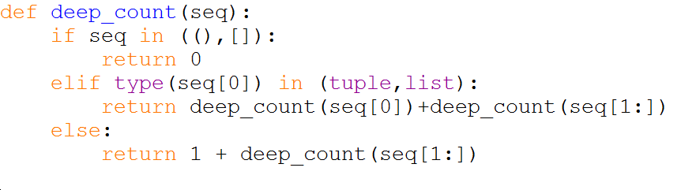
Deep Count
Same as
if seq == () or seq == []:
Notes:
Box-and-arrow diagram

Slide 27
LAB TIME!
Some reminders
Part A and Part B are 40% and 60% respectively
You should not use any package other than matplotlib.

